Slide 1

Practical deep learning for coders
Lesson 2
Jeremy Howard

Slide 2
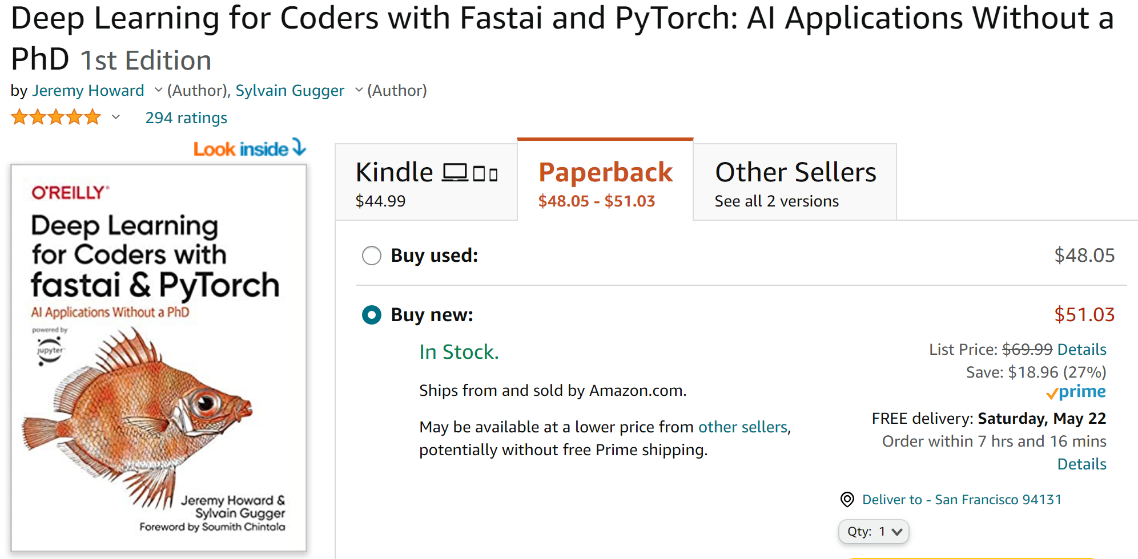
The book does an impressive job of covering the key applications of deep learning in computer vision, natural language processing, and tabular data processing, but also covers key topics like data ethics that some other books miss. Altogether, this is one of the best sources for a programmer to become proficient in deep learning -- Peter Norvig, Director of Research, Google As artificial intelligence has moved into the era of deep learning, it behooves all of us to learn as much as possible about how it works. Deep Learning for Coders provides a terrific way to initiate that, even for the uninitiated, achieving the feat of simplifying what most of us would consider highly complex -- Eric Topol, Author of Deep Medicine; Professor: Scripps Research

Slide 3
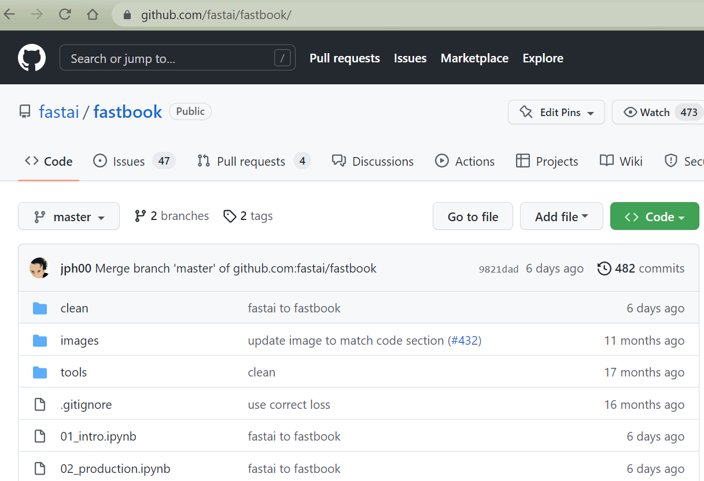
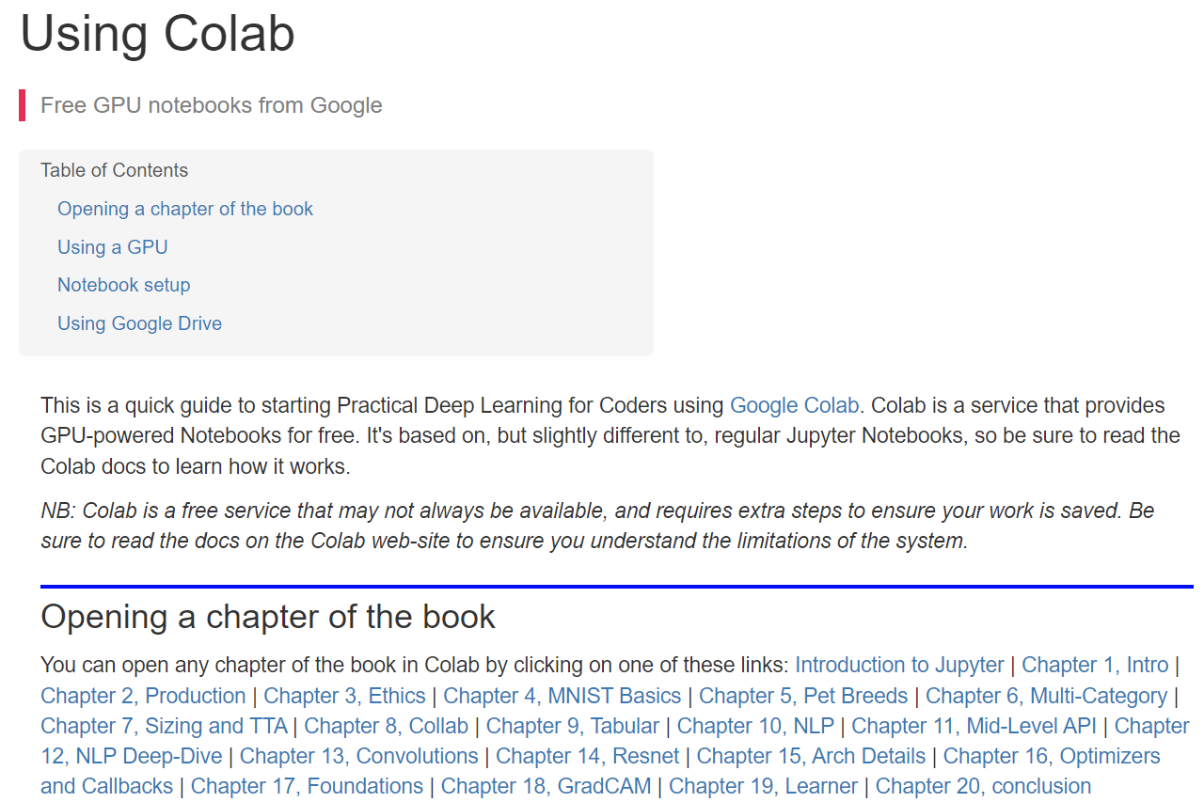
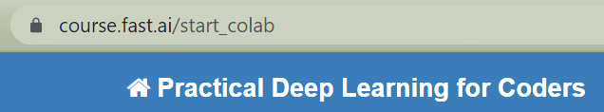

Slide 4
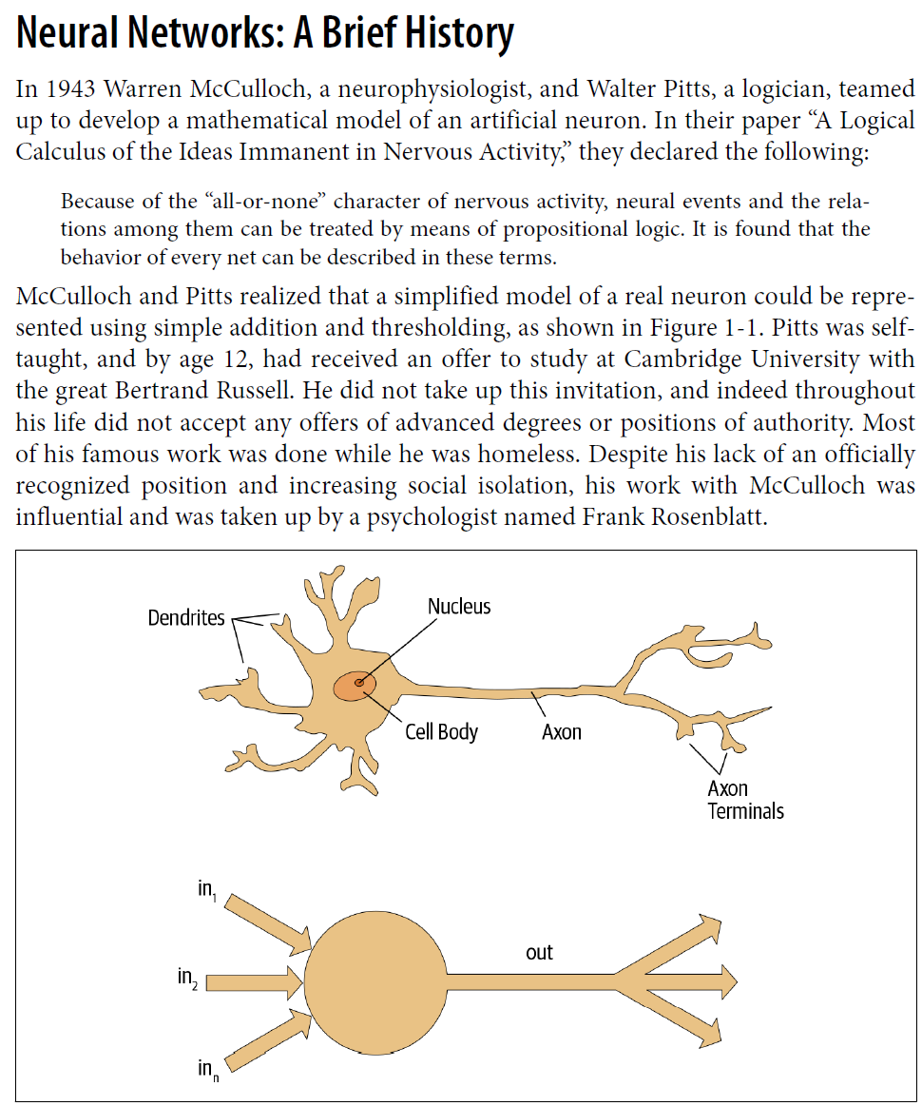

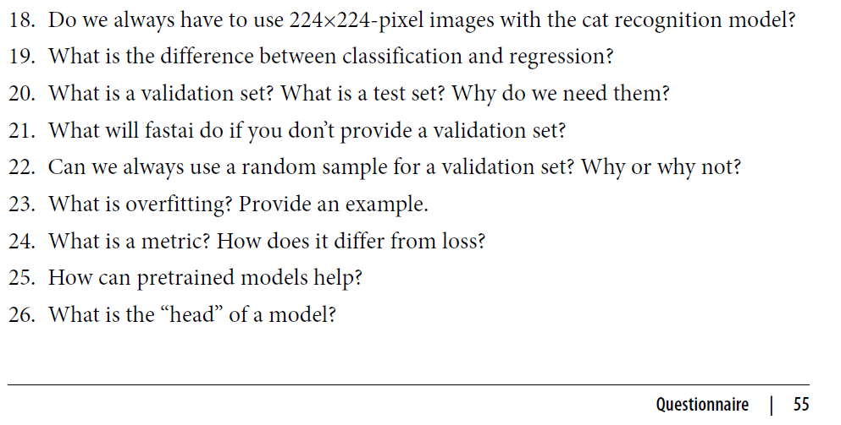

Slide 5
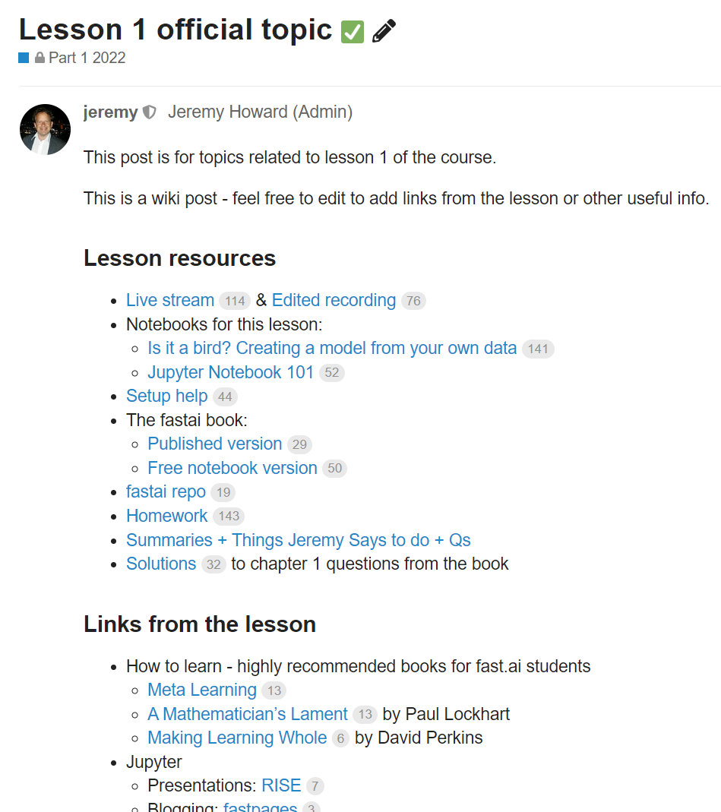
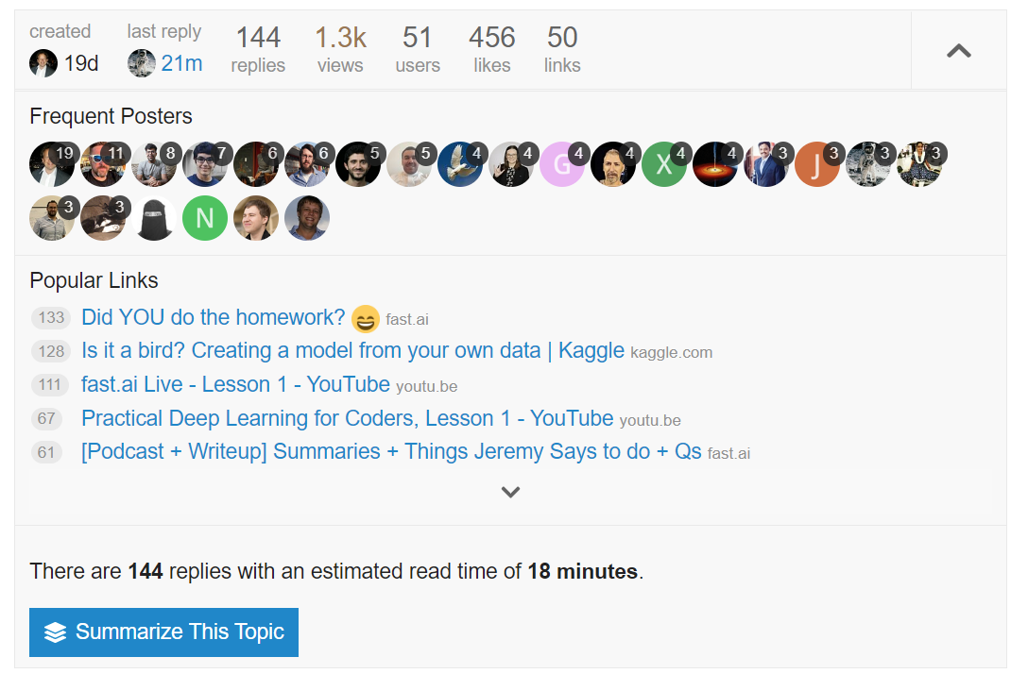
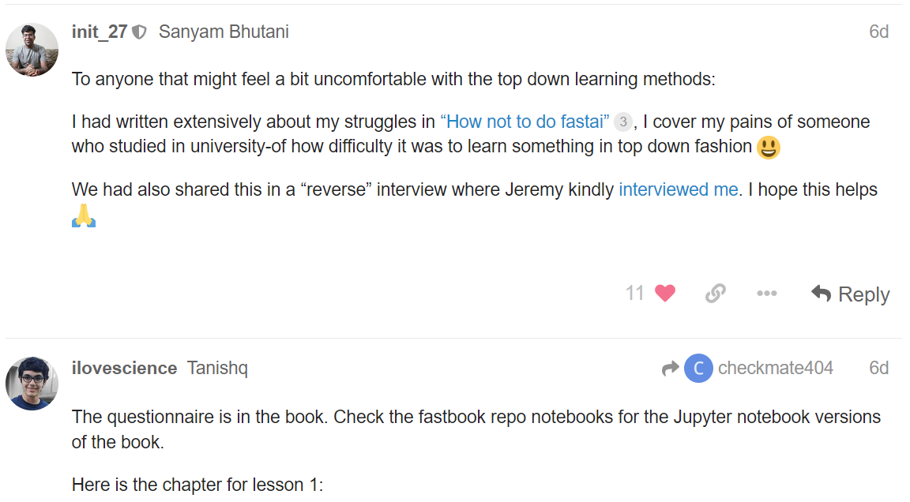

Slide 6
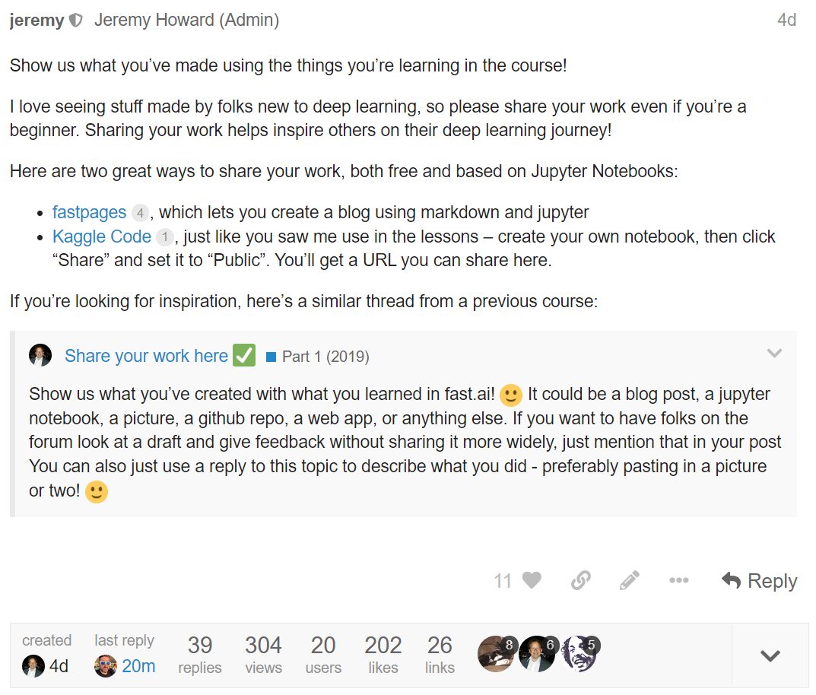
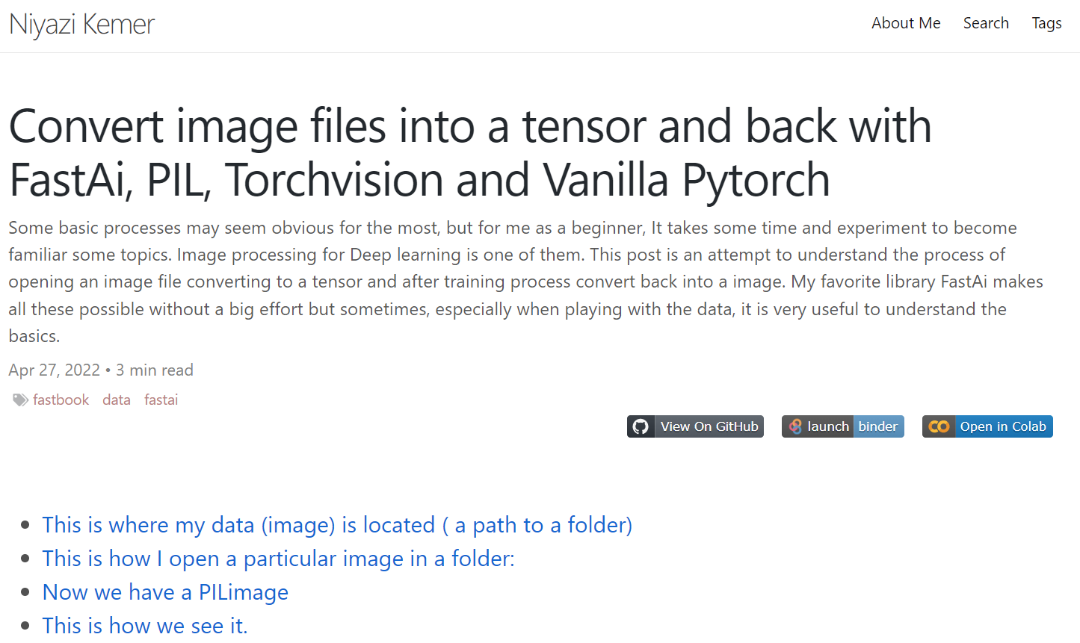
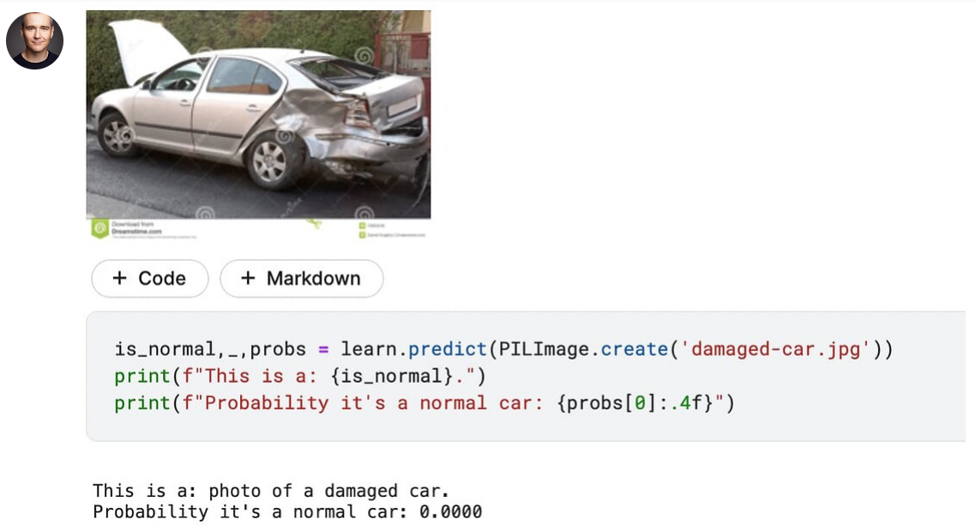

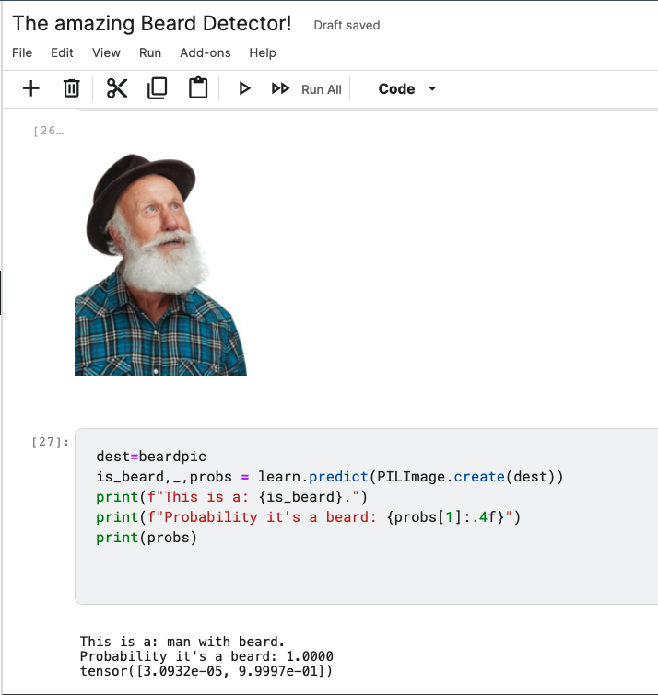
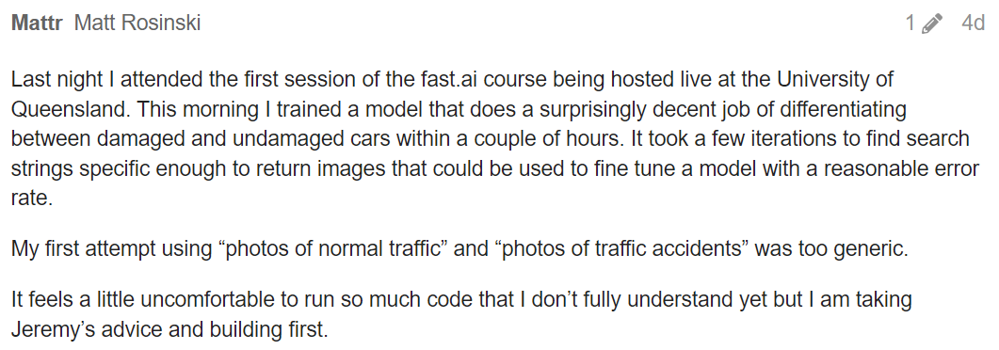
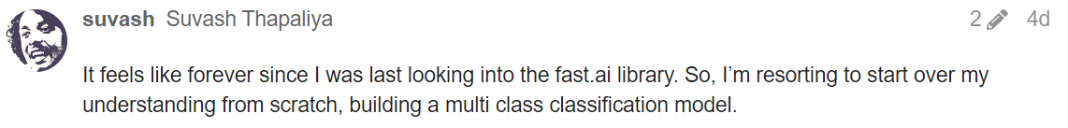

Slide 7
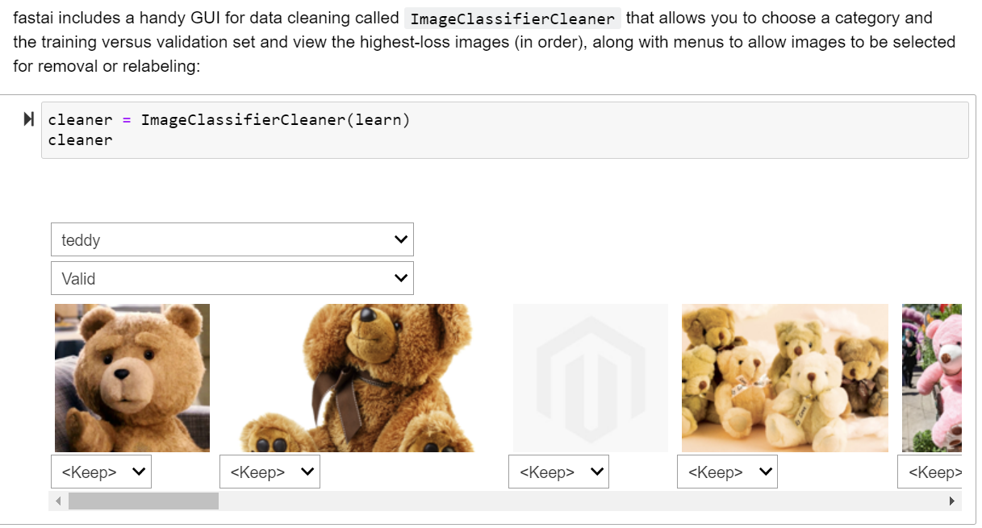

Slide 8
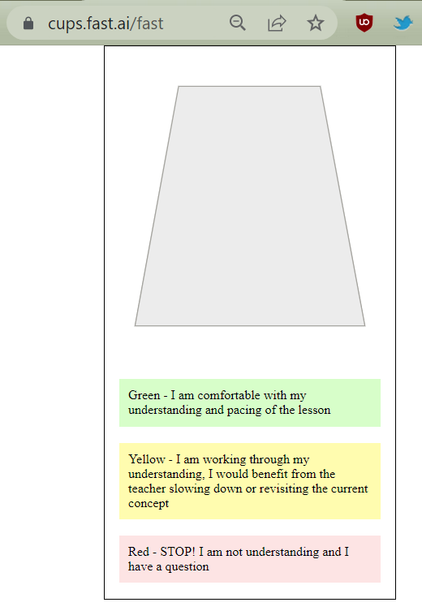

Slide 9



Slide 10
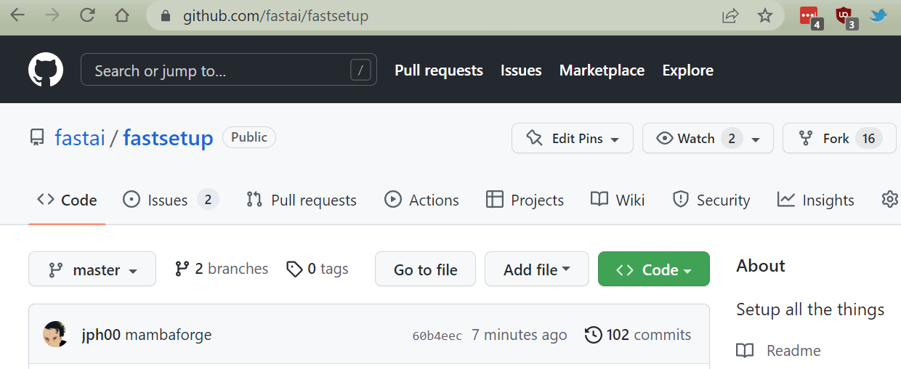

Slide 12
Try a basic interface
Try in a notebook
Use an exported learner
Create a “Space”
Use nbdev
Try the API (GitHub Pages)
Dogs vs Cats
Pet Breeds
git
conda

Slide 14
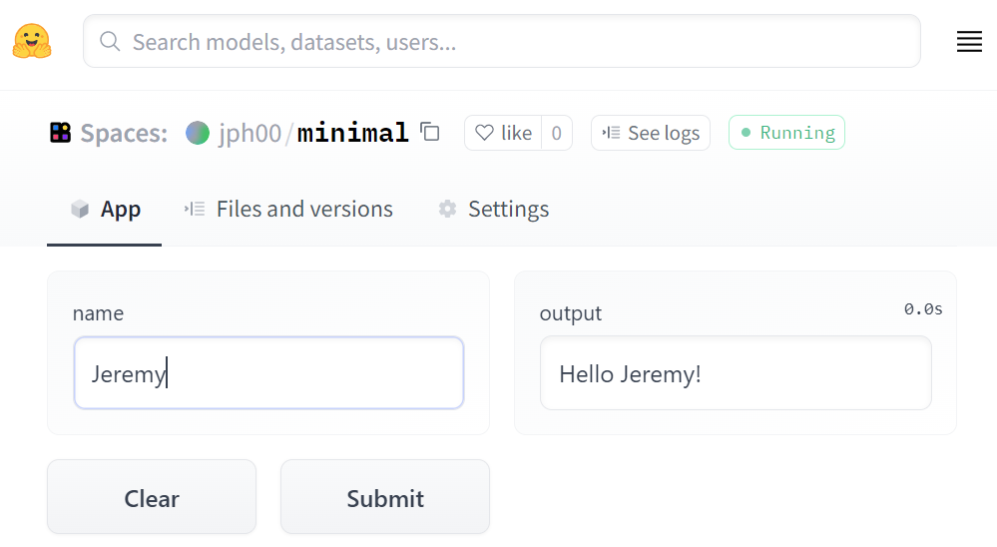

Slide 15
Infinitely flexible function
All-purpose parameter fitting
Fast and scalable
Neural Network
Gradient Descent
GPUs

